Slide 1
Bayes Theorem

Slide 2
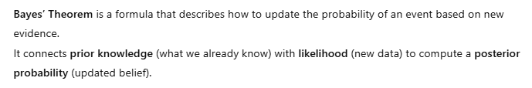
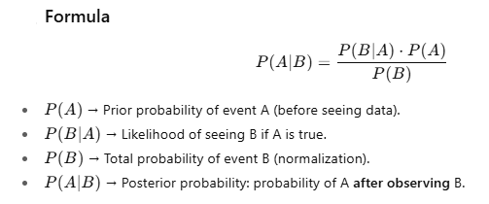

Slide 3
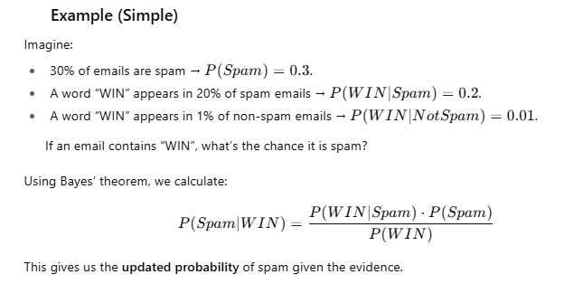

Slide 4
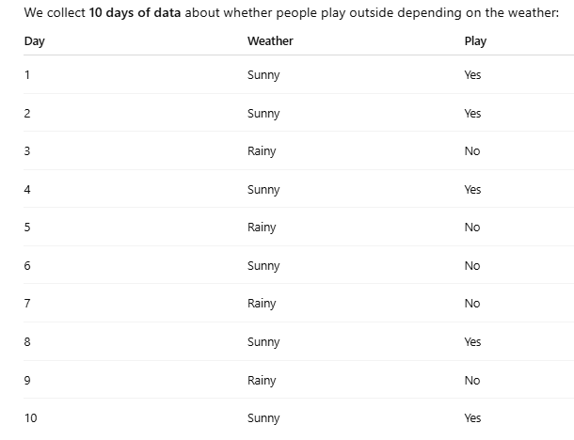

Slide 5
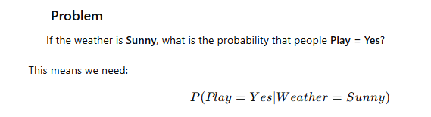
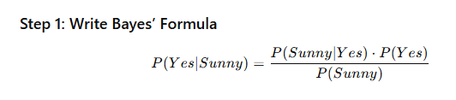

Slide 6
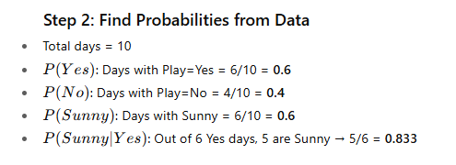

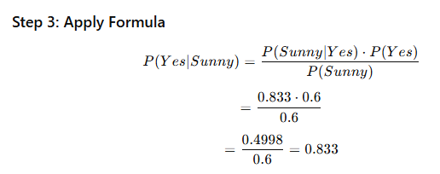

Slide 7


Slide 8
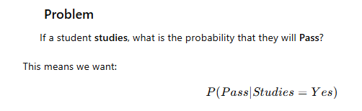
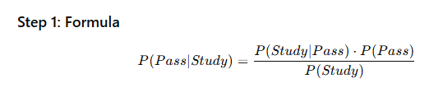
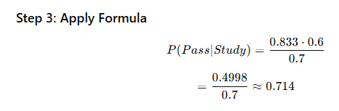
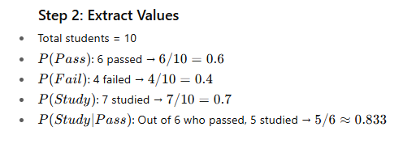


Slide 9
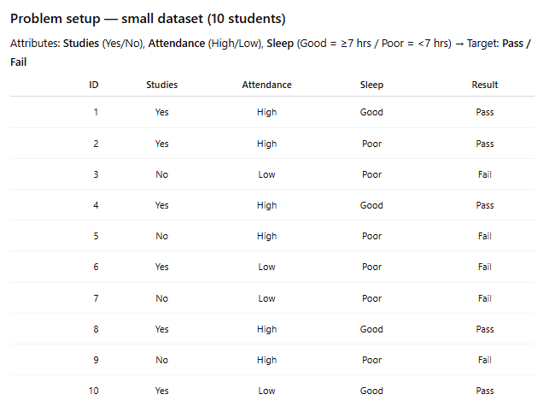

Slide 10
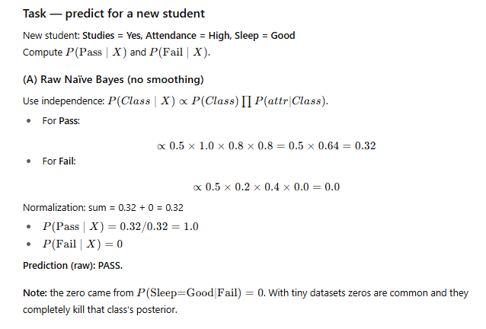
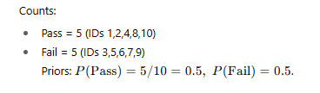
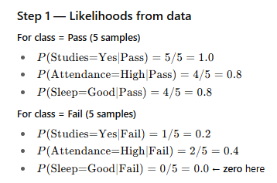

Slide 11
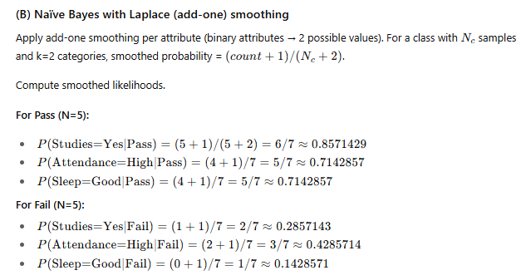
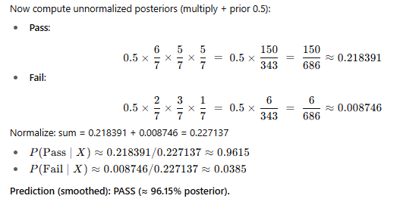

Slide 12
Naive Bayes Classification

Slide 13
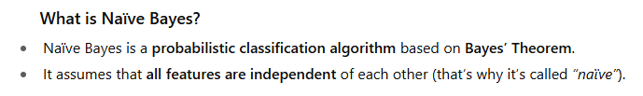
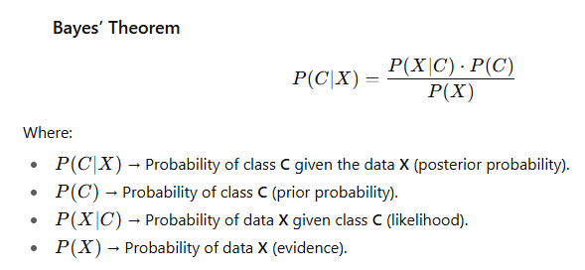

Slide 14
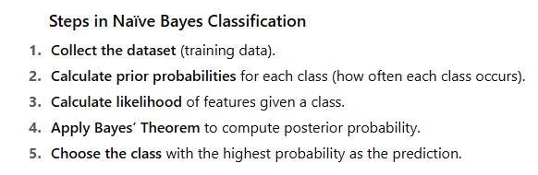
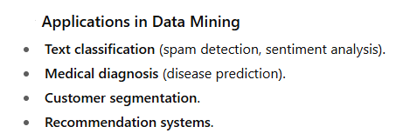

Slide 15
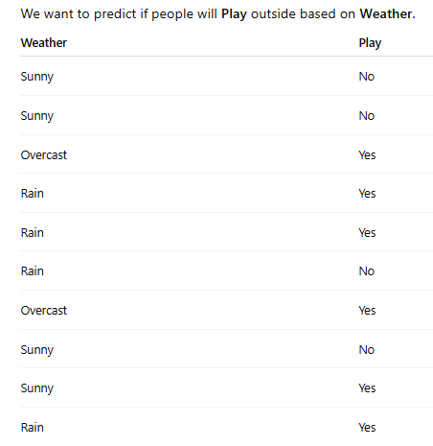
Example 1:

Slide 16
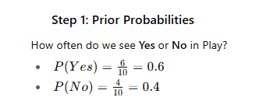
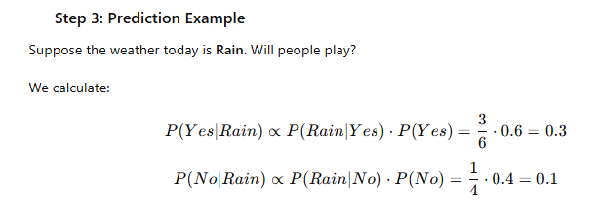
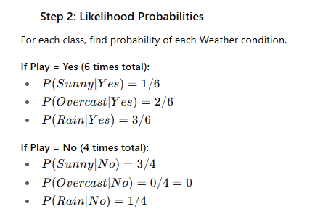
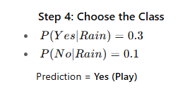

Slide 17
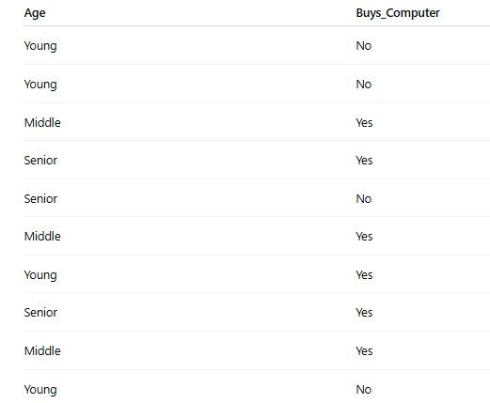
Example - 2

Slide 18
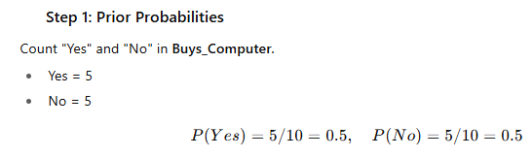
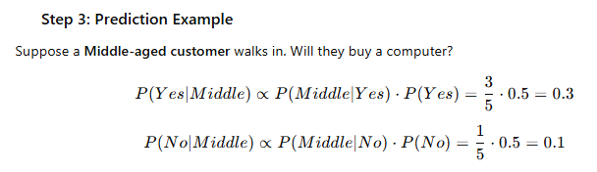
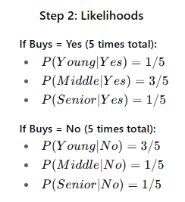
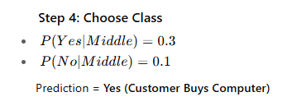

Slide 19
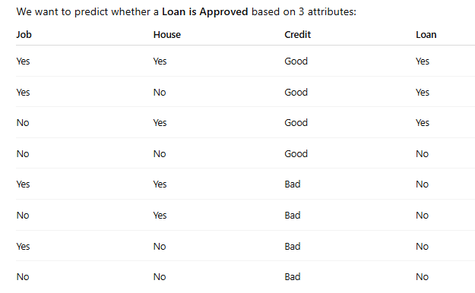
Example - 3

Slide 20
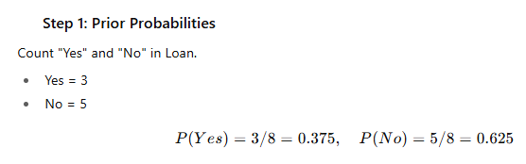
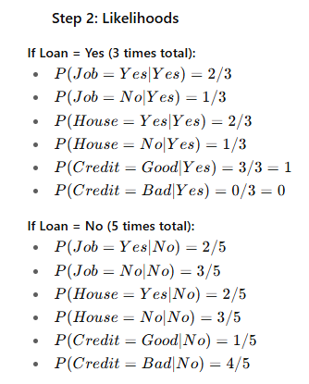
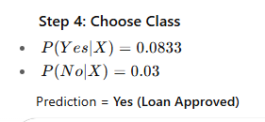
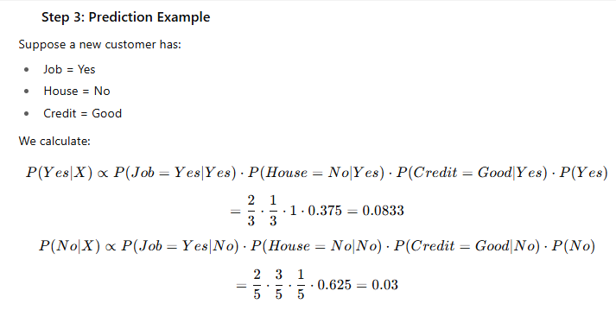

Slide 21
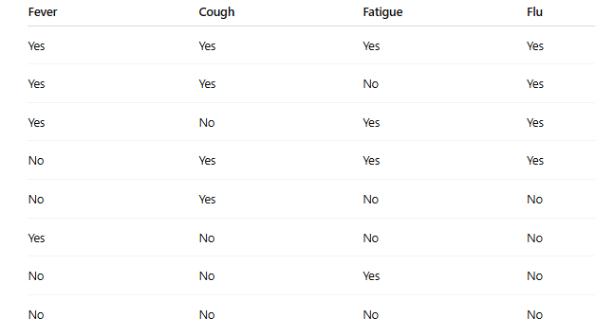
Example - 4

Slide 22
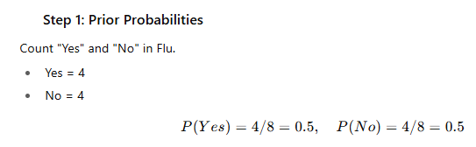
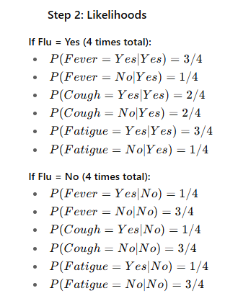
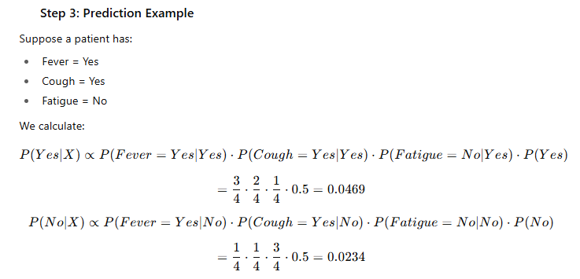
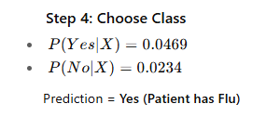

Slide 23
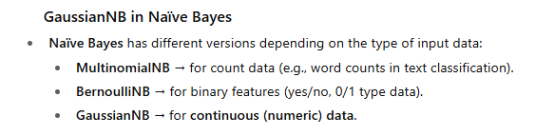
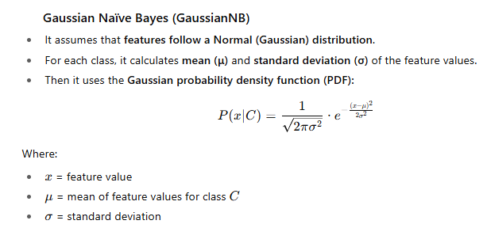
GaussianNB:

Slide 24
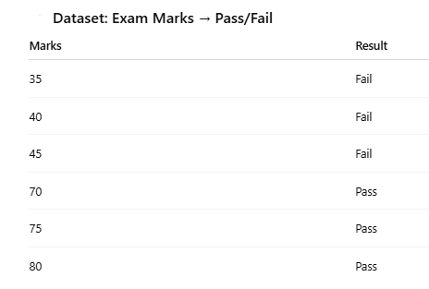
Example:

Slide 25

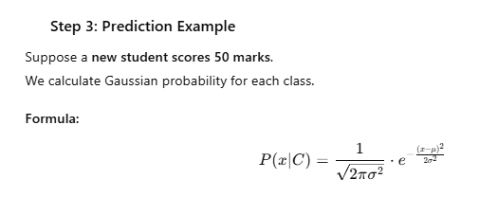
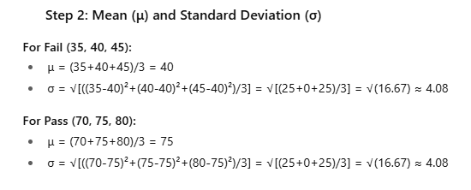

Slide 26
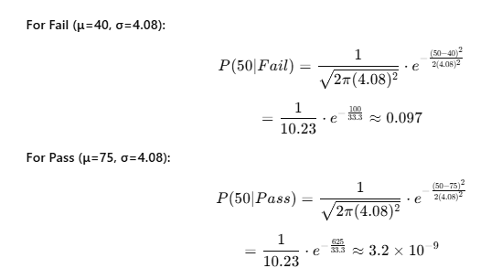
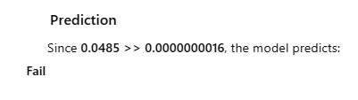


Slide 27
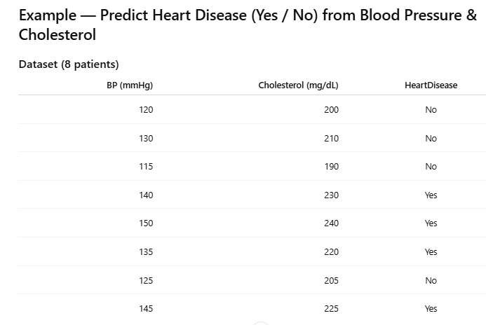

Slide 28


Slide 29


Slide 30



Slide 31


Slide 32

import numpy as np
from sklearn.naive_bayes import GaussianNB
# Small sample dataset
X = np.array([
[5.1, 3.5, 1.4, 0.2], # Setosa
[4.9, 3.0, 1.4, 0.2], # Setosa
[5.8, 2.7, 5.1, 1.9], # Virginica
[6.0, 2.2, 5.0, 1.5], # Virginica
[5.5, 2.3, 4.0, 1.3], # Versicolor
[6.5, 2.8, 4.6, 1.5] # Versicolor
])
y = np.array([
"Setosa", "Setosa", "Virginica",
"Virginica", "Versicolor", "Versicolor"
])
# Train GaussianNB
model = GaussianNB()
model.fit(X, y)
# Predict for new flower
sample = [[5.0, 3.4, 1.5, 0.2]]
prediction = model.predict(sample)
print("Prediction:", prediction[0])

Slide 33


Slide 34


Slide 35



Slide 36


Slide 37


Slide 38



Slide 39


Slide 40



Slide 41




Slide 42



Slide 43
Rule Based Classification

Slide 44




Slide 45


Slide 46


Slide 47


Slide 48


Slide 49



Slide 50


Slide 51



Slide 52




Slide 53




Slide 54





Slide 55


Slide 56


Slide 57








Slide 58


